Slide 1
Security in Solidity

Slide 2
Security attacks types
Overflows & Underflows
Delegatecall
Reentrancy (TheDAO hack)
Forcing ether to a contract
Call to the Unknown (DoS with unexpected revert)
Short Address Attack

Slide 3
Overflows & Underflows
An overflow is when a number gets incremented above its maximum value. Solidity can handle up to 256 bit numbers (up to 2²⁵⁶-1), so incrementing by 1 would result into 0.
Likewise, in the inverse case, when the number is unsigned, decrementing will underflow the number, resulting in the maximum possible value.
As dangerous as both cases are, the underflow case is the more likely to happen, for example in the case where a token holder has X tokens but attempts to spend X+1. If the code does not check for it, the attacker might end up being allowed to spend more tokens than he had and have a maxed out balance.

Slide 4
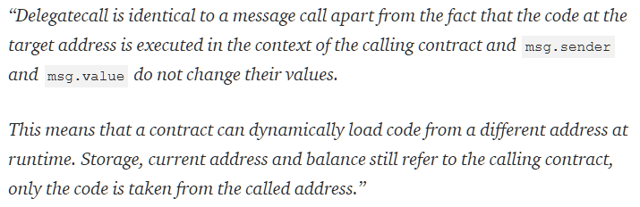
Delegatecall
It was the Parity wallet hack which cost users about 30 million dollars.
This low-level function has been very useful as it’s the backbone for implementing Libraries and modularizing code. However it opens up the doors to vulnerabilities as essentially your contract is allowing anyone to do whatever they want with their state.

Slide 5
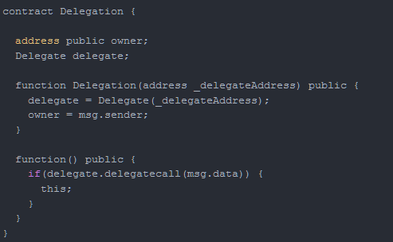
In the example below, an attacker can call contract Delegate’s public function pwn and since the call is in the context of Delegation, they can claim ownership of the contract.

Slide 6
The Parity hack involved a combination of both insecure visibility modifiers and misuse of delegate call with abritrary data. The vulnerable contract’s function implemented delegatecall and a function from another contract that could modify ownership was left public. That allowed an attacker to craft the msg.data field to call the vulnerable function.
As for what would be included in the msg.data field, that is the signature of the function that you want to call. Signature here means the first 8 bytes of the sha3 (alias for keccak256)hash of the function prototype.

Slide 7
In this case:
web3.sha3("pwn()").slice(0, 10) --> 0xdd365b8b
If the function takes an argument, pwn(uint256 x):
web3.sha3("pwn(uint256)").slice(0,10) --> 0x35f4581b

Slide 8
Reentrancy (TheDAO hack)
Solidity’s call function when called with value forwards all the gas it received.
In the next example, the call is made before actually reducing the sender’s balance.
This opened up a vulnerability which known as The DAO hack

Slide 9
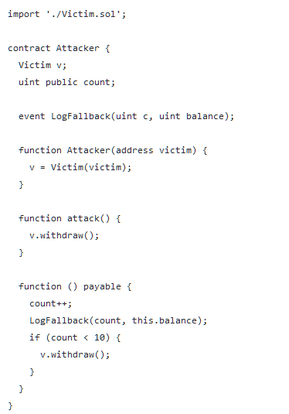
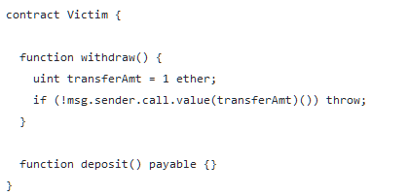

Slide 10
Forcing ether to a contract
Solidity’s selfdestruct does two things.
It renders the contract useless, effectively deleting the bytecode at that address.
It sends all the contract’s funds to a target address.
The special case here, is that if the receiving address is a contract, its fallback function does not get executed.
This means that if a contract’s function has a conditional statement that depends on that contract’s balance being below a certain amount, that statement can be potentially bypassed.

Slide 11
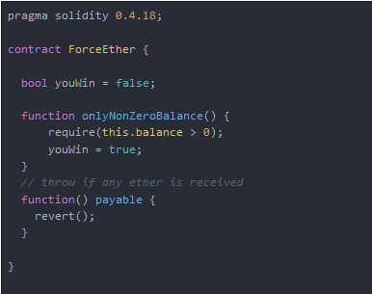

Slide 12
Call to the Unknown (DoS with unexpected revert)
In this case, an attacker’s contract could first claim leadership by sending enough ether to the insecure contract. Then, the transactions of another player who would attempt to claim leadership would throw due to line 25 in the above snippet.
Although a simple attack, this causes a permanent denial of service to the contract rendering it useless. This can be found in other ponzi scheme contracts that follow the same pattern.

Slide 13

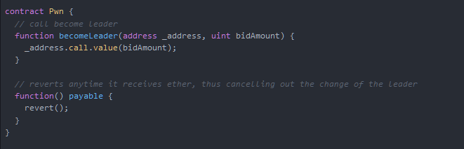

Slide 14
Short Address Attack
This vulnerability allows an attacker to abuse the transfer function and withdraw a larger amount of ERC20 tokens than he is allowed to.
To explain this bug let’s consider an exchange having a wallet with 10000 tokens and a user with a balance of 32 tokens on that exchange’s wallet.
Let’s also consider that this user’s address is 0x12345600 — notice the trailing zeroes — and that they want to withdraw an amount larger than their balance.
To do that they would go to the exchange and click the token’s withdraw button and input their address without the trailing zeroes

Slide 15
The ERC20’s transfer function is formulated as transfer(address to, uint256 amount). The 3 fields would be as follows:
sig : a9059cbb = web3.sha3("transfer(address,uint256)").slice(0,10)
arg1: 123456 = receiving address
arg2: 00000020 = 32 in hexademical (0x20)
Concatenated: a9059cbb 123456 00000020
Transaction input data: 0xa9059cbb12345600000020

Slide 16
Looking closely, the transaction’s length is 2 bytes shorter (4 bytes in the real world with full words). The EVM in this case would pad the transaction with trailing zeroes, resulting in:
0xa9059cbb1234560000002000
// a9059cbb = web3.sha3("transfer(address,uint256)").slice(0,10)
// 12345600 = receiving address
// 00002000 = 8192 in hexademical

